Slide 1
A* Search

Slide 2
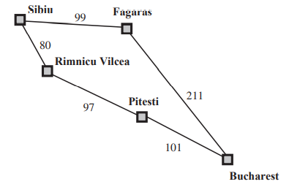
Let’s solve the following problem

Slide 3
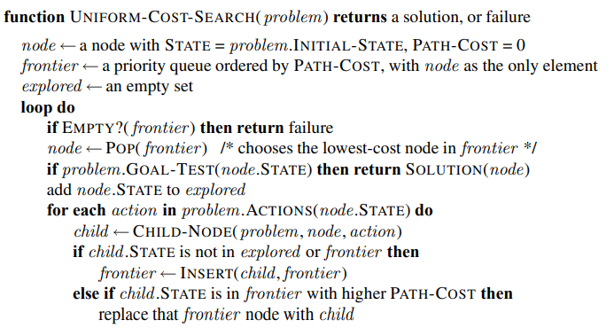
Uniform Cost Search Algorithm
Path Cost=g(n)

Slide 4
A * Search
Path Cost=g(n)+h(n)

Slide 5
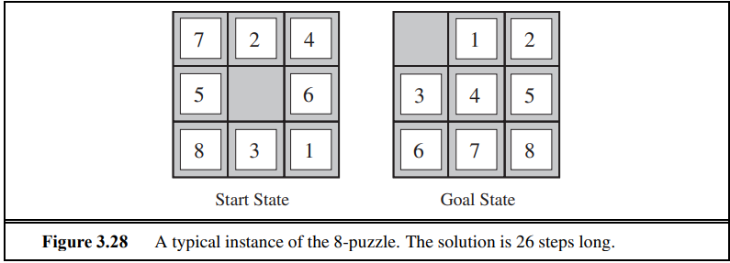
Let’s Solve this one

Slide 6
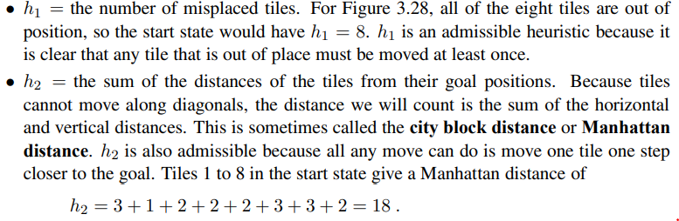
Potential Heuristics

Slide 7
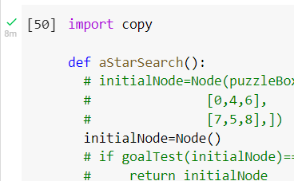

Slide 8

Homework(Assignment) Time

